Slide 1


Online Shopping System
TEAM MEMBERS
B . ASHRITHA VARALAKSHMI 25B11CS083
N. SRI SNEHITHA 25B11CS657
A. SYAMALADEVI 25B11CS016
K. HANSIKA 25B11CS447

Slide 2

Project Abstract
The Online Shopping System is a database management project designed to manage customers, employees, products, product categories, orders, tracking details, and carts efficiently. The system stores and organizes data using relational tables with primary keys and foreign keys to maintain data integrity. An ER diagram, cardinalities, and schema model are used to design the database structure. SQL queries are used to insert, retrieve, update, and analyze the data. Normalization up to 3NF is applied to reduce data redundancy and avoid insertion, deletion, and update anomalies. Overall, the project provides a structured and efficient database for managing online shopping operations.

Slide 3
Problem Statement
Managing customer information efficiently.
Maintaining product and product category details.
Managing orders and order-related information.
Tracking the status and location of orders.
Managing shopping cart details and quantities.
Reducing data redundancy and inconsistency.
Maintaining data integrity using primary and foreign keys.
Providing easy and efficient access to shopping information using SQL queries.

Slide 4

Project Objectives
To design a structured database for managing online shopping information.
To efficiently manage customers, employees, products, orders, carts, and tracking details.
To establish relationships between tables using primary keys and foreign keys.
To reduce data redundancy and maintain data consistency through normalization.
To retrieve and manage shopping information efficiently using SQL queries.

Slide 5
REQUIREMENTS AND END USERS
Functional Requirements
• Add/Edit Customer Details
• Manage Products and Categories
• Place and Manage Orders
• Manage Shopping Cart
• Track Order Status and Location
• Store Employee Details
• Manage User and Payment Details
Non-Functional Requirements
• Security
• Fast Performance
• Easy to Use
• Reliable Database
• Data Integrity
• Reduced Data Redundancy
End Users
• Customer
• Administrator
• Employee
• Database Administrator

Slide 6
SCHEMA – ONLINE SHOPPING SYSTEM
PAYMENT
Payment_ID — STRING, Payment_Mode — STRING, Amount — STRING, Payment_Status — STRING,Order_ID — STRING, REFERENCES ORDER(Order_ID)
CUSTOMER
Customer_ID — PRINT,Name — STRING,Email — STRING,Phone — STRING,Address — STRING
ORDER
Order_ID — STRING,Order_Date — DATE, Total_Amount — INTEGER ,Order_Status — STRING,Customer_ID — STRING
REFERENCES CUSTOMER(Customer_ID)
PRODUCT
Product_ID —STRING, Product_Name – STIRNG,Price — STIRNG,Quantity — STRING, Category_ID — STRING, REFERENCES CATEGORY(Category_ID)
CATEGORY
Category_ID —STRING, Category_Name —STRING
ORDER ITEM
Order_ID – STRING, Quantity – INTEGER, Price – INTEGER, Product_ID – STRING
DELIVERY
Delivery_ID – STRING, DeliveryDate – STRING, Address – STRING, Status – STRING

Slide 7
PRIMARY AND FOREIGN KEYS
Primary Keys (PK):
u_id → Uniquely identifies a user.
tracking_id → Uniquely identifies a customer.
emp_id → Uniquely identifies an employee.
c_id → Uniquely identifies a product category.
p_id → Uniquely identifies a product.
order_no + product_id → Together uniquely identify an order item.
t_id → Uniquely identifies tracking details.
cart_id → Uniquely identifies a cart.
Foreign Keys (FK):
u_id in CUSTOMER → Links customer to USER.
u_id in EMPLOYEE → Links employee to USER.
c_id in PRODUCT → Links product to PRODUCT_CATEGORY.
u_id in ORDERS → Links order to USER.
product_id in ORDERS → Links order to PRODUCT.
order_no in TRACKING_DETAIL → Links tracking details to ORDERS.
u_id in CART → Links cart to USER.

Slide 8
Mapping Cardinalities
Relationship | Cardinality | Type
User-makes-Order | M:1 | Many to One
User-makes-Payment | 1:M | One to Many
User-has-Address | 1:M | One to Many
Order-contains -Product | 1:M | One to Many
Order - has -Tracking Detail | 1:M | One to Many
Product-has-Product-Category | M:1 | Many to One
Product - added to - Cart | M:M | Many to Many

Slide 9
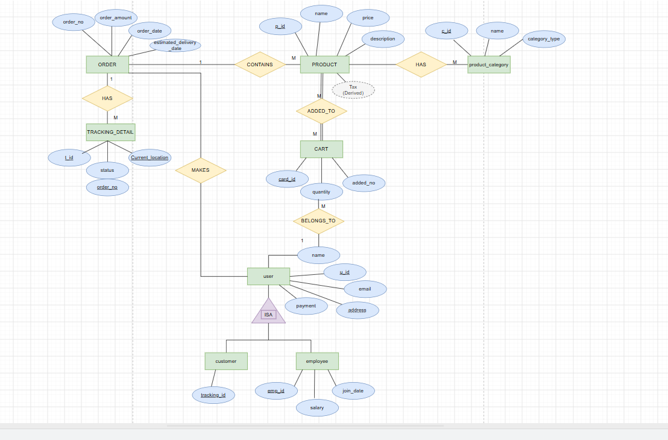
ER DIAGRAM

Slide 10
RELATIONSHIPS
Relationship | Entities | Meaning
MAKES | User – Order | User places an order
CONTAINS | Order – Product | Order contains products
HAS | Product Category – Product | Category contains products
ADDED_TO | Product – Cart | Product is added to cart
BELONGS_TO | Cart – User | Cart belongs to user
HAS | Order – Tracking Detail | Order has tracking records
ISA | User – Customer/Employee | Customer and Employee are specialized Users

Slide 11
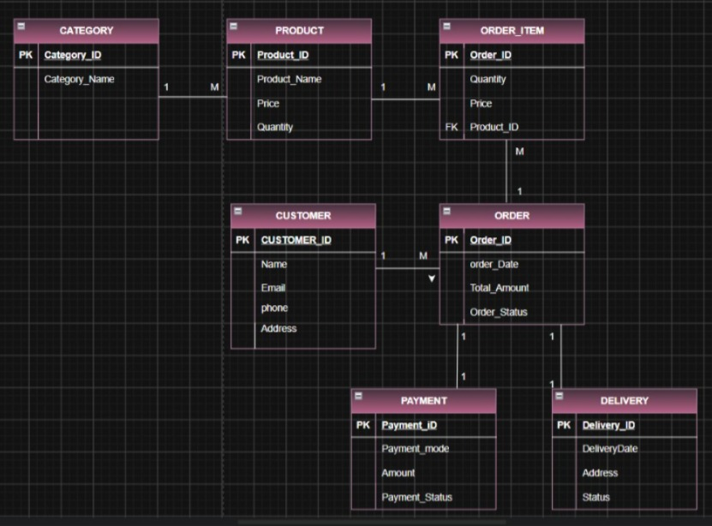
Schema

Slide 12
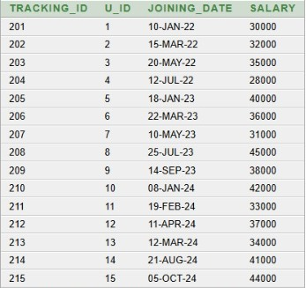
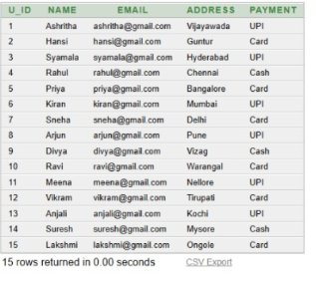
TABLE CREATION
USER:
CREATE TABLE users (
u_id INT PRIMARY KEY,
name VARCHAR2(20),
email VARCHAR2(20),
address VARCHAR2(20),
payment VARCHAR2(20)
);
OUTPUT:
CUSTOMERS:
CREATE TABLE customer (
tracking_id NUMBER PRIMARY KEY,
u_id NUMBER,
joining_date DATE,
salary NUMBER(10,2),
FOREIGN KEY (u_id) REFERENCES users(u_id)
);
OUTPUT:

Slide 13
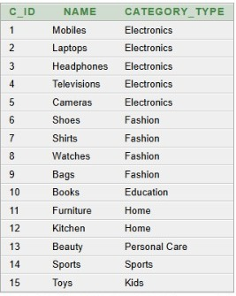
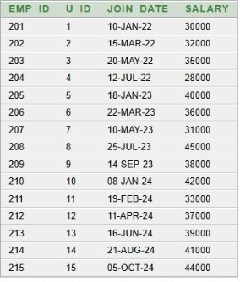
EMPLOYEE:
create table employee (
emp_id number primary key,
u_id number,
join_date date,
salary number(10,2),
foreign key (u_id) references users(u_id)
);
OUTPUT:
PRODUCT CATEGORY:
create table product_category (
c_id number primary key,
name varchar2(20),
category_type varchar2(20)
);
OUTPUT:

Slide 14
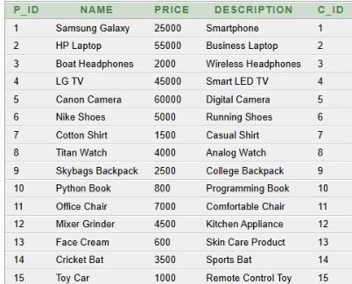
PRODUCT:
creat table product (
p_id number primary key,
name varchar2(20),
price number(10,2),
description varchar2(20),
c_id number,
foreign key (c_id) references product_category(c_id)
);
OUTPUT:
ORDERS:
CREATE TABLE ors (
order_no NUMBER,
u_id NUMBER,
order_date DATE
customer_name VARCHAR2(20),
customer_email VARCHAR2(30),
product_id NUMBER,
product_name VARCHAR2(20),
product_price NUMBER(10,2),
quantity NUMBER,
order_amount NUMBER(10,2),
payment VARCHAR2(20),
PRIMARY KEY (order_no, product_id),
FOREIGN KEY (u_id) REFERENCES users(u_id),
FOREIGN KEY (product_id) REFERENCES product(p_id)
);

Slide 15
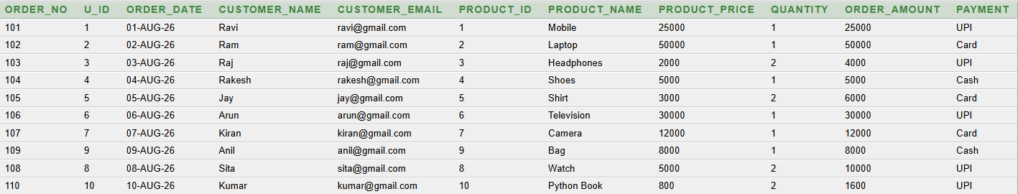
OUTPUT:

Slide 16
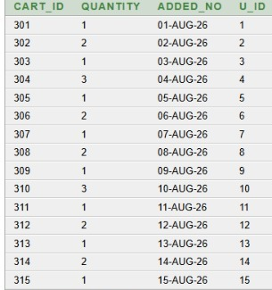
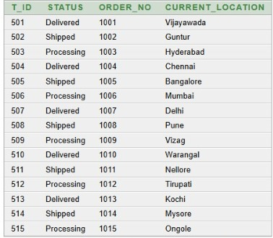
CART:
create table cart (
cart_id number primary key,
quantity number,
added_no date,
u_id number,
foreign key (u_id) references users(u_id)
);
OUTPUT:
TRAKING DETAIL:
create table tracking_detail (
t_id number primary key,
status varchar2(50),
order_no number,
current_location varchar2(100),
foreign key (order_no) references orders(order_no)
);
OUTPUT:

Slide 17
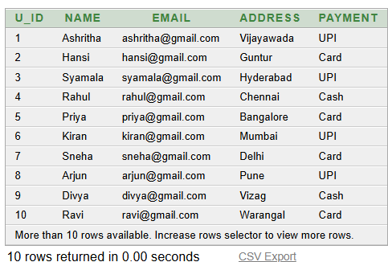
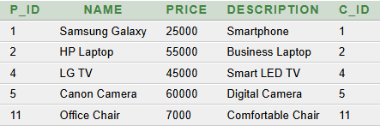
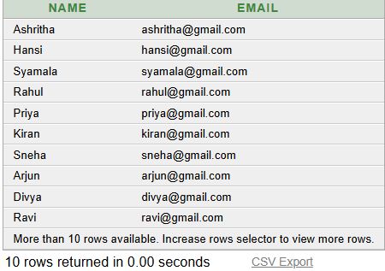
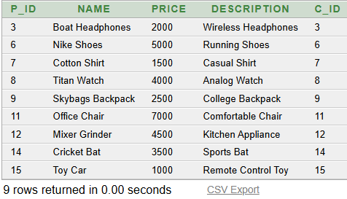
QUERIES
DISPLAY ALL USERS
SELECT * FROM users;
3. FIND PRODUCT WITH PRICE GREATER THAN 5000
SELECT *FROM product WHERE price > 5000;
4. FIND PRODUCTS WITH PRICE BETWEEN 1000 AND 1000
SELECT *FROM product WHERE price BETWEEN 1000 AND 10000;
2. DISPLAY ONLY USER NAMES AND EMAILS.
SELECT name, email FROM users;

Slide 18
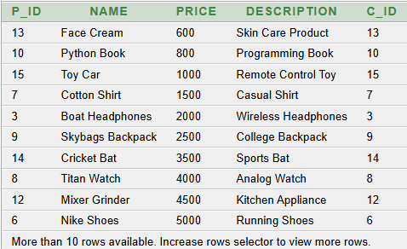
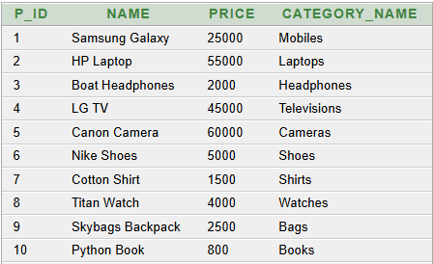
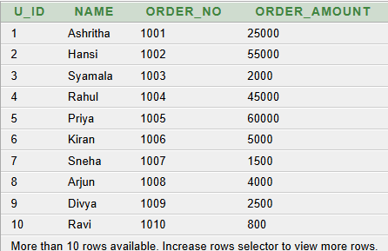
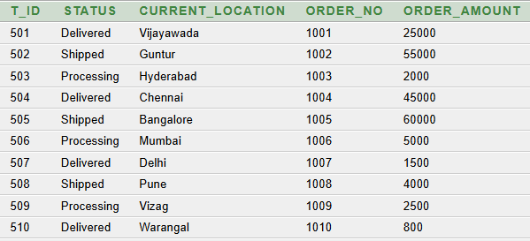
5. DISPLAY PRODUCTS IN ASCENDING ORDER OF PRICE.
SELECT *FROM product ORDER BY price ASC;
6. DISPLAY THE USERID, CUSTOME NAME ,ORDER NAME AND OREDER AMOUNT ALONG WITH CUSTOMER
SELECT u.u_id, u.name, o.order_no, o.order_amount
FROM users u
JOIN orders o
ON u.u_id = o.u_id;
7. DISPLAY PRODUCT DETILS ALONG WITH
CATEGORY DETAILS
SELECT p.p_id, p.name, p.price, pc.name AS category_name
FROM product p
JOIN product_category pc
ON p.c_id = pc.c_id;
8. DISPLAY TRACKING DETAILS WITH CORRESPONDING ORDER
SELECT t.t_id, t.status, t.current_location,
o.order_no, o.order_amount
FROM tracking_detail t
JOIN orders o
ON t.order_no = o.order_no;

Slide 19

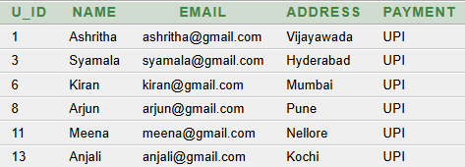
9. FIND THE AVERAGE EMPLOYEE SALARY
SELECT AVG(salary) AS average_salary FROM employee;
10. DISPLAY ALL USERS WHO PAID USING UPI
SELECT *FROM users WHERE payment = 'UPI’;

Slide 20
NORMALIZATION
Normalization is the process of organizing data in a database to reduce data redundancy (duplicate data) and improve data consistency and integrity.
It involves dividing large tables into smaller, related tables and establishing relationships between them using keys.
Types of Normalization
1NF ( First Normal Form)
2NF ( Second Normal Form )
3NF ( Third Normal Form )

Slide 21
1NF
In 1NF, all values in the table are made atomic, meaning each cell contains only one value. Repeating or multiple values are separated into individual rows. This makes the data organized and easy to access.
In our Orders table, some orders contained multiple products in the same row. To convert it into 1NF, we separated the multiple product values into individual rows. Each cell now contains only one value, while the order details are repeated for each product. Thus, the table contains atomic values and satisfies 1NF.
CREATE TABLE orders_1nf (
order_no NUMBER,
u_id NUMBER,
order_date DATE,
customer_name VARCHAR2(20),
customer_email VARCHAR2(30),
product_id NUMBER,
product_name VARCHAR2(20),
product_price NUMBER(10,2),
quantity NUMBER,
order_amount NUMBER(10,2),
payment VARCHAR2(20),
PRIMARY KEY (order_no, product_id)
);

Slide 22
FIRST NORMALISATION FORM(1NF)
FUNCTIONAL DEPENDENCIES:
ORDER_NO → U_ID, ORDER_DATE, CUSTOMER_NAME, CUSTOMER_EMAIL, ORDER_AMOUNT, PAYMENT
PRODUCT_ID → PRODUCT_NAME, PRODUCT_PRICE
(ORDER_NO, PRODUCT_ID) → QUANTITY
ORDER_NO | U_ID | ORDER_DATE | CUSTOMER_NAME | CUSTOMER_EMAIL | PRODUCT_ID | PRODUCT_NAME | PRODUCT_PRICE | QUANTITY | ORDER_AMOUNT | PAYMENT
101 | 1 | 01-AUG-26 | Ravi | ravi@gmail.com | 1 | Mobile | 25000 | 1 | 250000 | UPI
101 | 1 | 01-AUG-26 | Ravi | ravi@gmail.com | 2 | Laptop | 50000 | 2 | 125000 | UPI
102 | 2 | 02-AUG-26 | Ram | ram@gmail.com | 3 | Headphones | 2000 | 2 | 4000 | Card
103 | 3 | 03-AUG-26 | Raj | raj@gmail.com | 4 | Shoes | 5000 | 1 | 5000 | UPI
103 | 3 | 03-AUG-26 | Raj | raj@gmail.com | 5 | Shirt | 3000 | 2 | 11000 | UPI
104 | 4 | 04-AUG-26 | Rakesh | rakesh@gmail.com | 6 | Television | 30000 | 1 | 30000 | Cash
105 | 5 | 05-AUG-26 | Jay | jay@gmail.com | 7 | Camera | 12000 | 1 | 12000 | Card
106 | 6 | 06-AUG-26 | Arun | arun@gmail.com | 8 | Watch | 5000 | 2 | 10000 | UPI
107 | 7 | 07-AUG-26 | Kiran | kiran@gmail.com | 9 | Bag | 8000 | 1 | 8000 | Card
108 | 8 | 08-AUG-26 | Sita | sita@gmail.com | 10 | Python Book | 800 | 2 | 1600 | UPI

Slide 23
CONVERSION FROM 1NF TO2NF
2NF is a table that is in 1NF and has no partial dependency.
In our 1NF table, we used ORDER_NO + PRODUCT_ID as a composite primary key. Some attributes depended only on ORDER_NO, while product details depended only on PRODUCT_ID. To remove these partial dependencies, we divided the table into two tables: Orders and Order_Items.
CREATE TABLE orders_2nf (
order_no NUMBER PRIMARY KEY,
u_id NUMBER,
order_date DATE,
customer_name VARCHAR2(20),
customer_email VARCHAR2(30),
order_amount NUMBER(10,2),
payment VARCHAR2(20)
);

Slide 24
CONVERSION FROM 1NF TO 2NF
FUNCTIONAL DEPENDENCIES:
Functional Dependencies
ORDER_NO → U_ID
ORDER_NO → ORDER_DATE
ORDER_NO → CUSTOMER_NAME
ORDER_NO → CUSTOMER_EMAIL
ORDER_NO → ORDER_AMOUNT
ORDER_NO → PAYMENT
U_ID → CUSTOMER_NAME
U_ID → CUSTOMER_EMAIL
CUSTOMER_EMAIL → U_ID
CUSTOMER_EMAIL → CUSTOMER_NAME
ORDER_NO | U_ID | ORDER_DATE | CUSTOMER_NAME | CUSTOMER_EMAIL | ORDER_AMOUNT | PAYMENT
101 | 1 | 01-AUG-26 | Ravi | ravi@gmail.com | 125000 | UPI
102 | 2 | 02-AUG-26 | Ram | ram@gmail.com | 4000 | Card
103 | 3 | 03-AUG-26 | Raj | raj@gmail.com | 11000 | UPI
104 | 4 | 04-AUG-26 | Rakesh | rakesh@gmail.com | 30000 | Cash
105 | 5 | 05-AUG-26 | Jay | jay@gmail.com | 6000 | Card
106 | 6 | 06-AUG-26 | Arun | arun@gmail.com | 10000 | UPI
107 | 7 | 07-AUG-26 | Kiran | kiran@gmail.com | 8000 | Card
108 | 8 | 08-AUG-26 | Sita | sita@gmail.com | 1600 | UPI
109 | 9 | 09-AUG-26 | Anil | anil@gmail.com | 27000 | Cash
110 | 10 | 10-AUG-26 | Kumar | kumar@gmail.com | 14000 | UPI

Slide 25
CONVERSION FROM 1NF TO 2NF
ORDER_NO | PRODUCT_ID | PRODUCT_NAME | PRODUCT_PRICE | QUANTITY
101 | 1 | Mobile | 25000 | 1
101 | 2 | Laptop | 50000 | 2
102 | 3 | Headphones | 2000 | 2
103 | 4 | Shoes | 5000 | 1
103 | 5 | Shirt | 3000 | 2
104 | 6 | Television | 30000 | 1
105 | 7 | Camera | 12000 | 1
106 | 8 | Watch | 5000 | 2
107 | 9 | Bag | 8000 | 1
108 | 10 | Python Book | 800 | 2
109 | 1 | Mobile | 25000 | 1
109 | 3 | Headphones | 2000 | 1
110 | 5 | Shirt | 3000 | 2
110 | 9 | Bag | 8000 | 1

Slide 26
3NF
3NF (Third Normal Form) is a table that is in 2NF and has no transitive dependency.
In our 2NF tables, some details still depended on other non-key attributes:
CUSTOMER_NAME, CUSTOMER_EMAIL, and PAYMENT depend on U_ID.
PRODUCT_NAME and PRODUCT_PRICE depend on PRODUCT_ID.
To remove these transitive dependencies, we keep:
Customer details in the Users table.
Product details in the Product table.
Only U_ID and PRODUCT_ID are stored in the order-related tables.
Therefore, the tables satisfy 3NF.

Slide 27
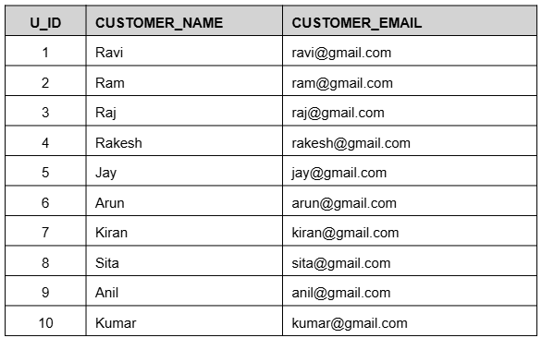
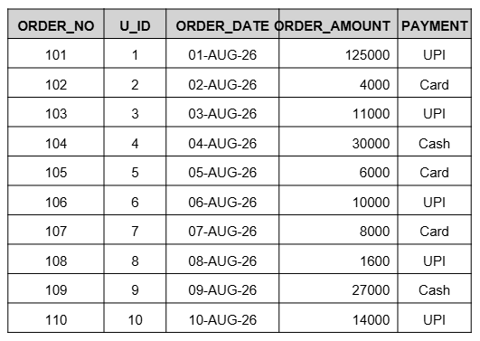
CONVERSION FROM 2NF TO 3NF
Functional Dependencies:
1. ORDER_NO → U_ID, ORDER_DATE, ORDER_AMOUNT
2. (ORDER_NO, PRODUCT_ID) → QUANTITY
Primary Key: ORDER_NO
Foreign Key: U_ID → CUSTOMER(U_ID)
Primary Key: U_ID

Slide 28
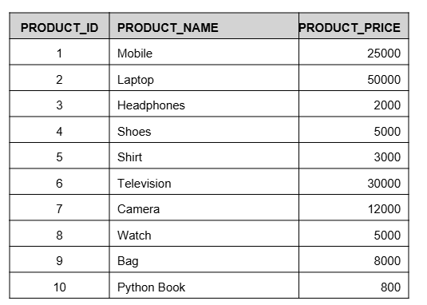
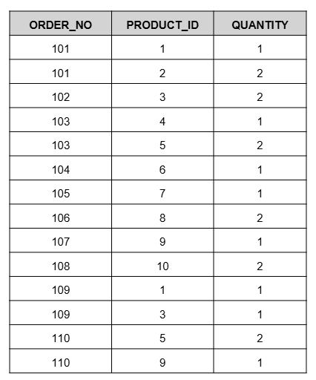
CONVERSION FROM 2NF TO 3NF
Primary Key: (ORDER_NO, PRODUCT_ID)
Foreign keys:ORDER_NO → ORDERS(ORDER_NO)PRODUCT_ID → PRODUCT(PRODUCT_ID)
Primary Key: PRODUCT_ID

Slide 29
ADVANTAGES AND FUTURE SCOPE
Advantages
Reduces data redundancy
Maintains data consistency and integrity
Provides easy data management
Improves order and product tracking
Enables fast data retrieval using SQL queries
Organizes customer, product, and order information efficiently
Supports secure and reliable database operations
Future Scope
Develop a complete web or mobile application
Add online payment gateway integration
Implement real-time order tracking
Add product recommendation features
Provide sales and customer analytics
Add notifications for order updates
Improve database security and user authentication
Support multiple vendors and delivery partners

Slide 30
CONCLUSION
The Online Shopping System successfully provides a structured database for managing customers, employees, products, categories, orders, carts, and order tracking. Primary keys and foreign keys maintain data integrity and relationships between tables. SQL queries help retrieve and manage information efficiently. Normalization up to 3NF reduces data redundancy and avoids data anomalies. Overall, the project provides an organized and efficient database solution for online shopping management.

Slide 31
Thank You!

